Slide 1
Case Example 2: PBPK model
nlmixr course PAGE 2019 Stockholm, June 11th 2019
Mirjam Trame, Wenping Wang
On behalf of the nlmixr development team:
Matt Fidler, Richard Hooijmaijers, Teun Post, Rik Schoemaker, Mirjam Trame, Justin Wilkins, Yuan Xiong and Wenping Wang

Slide 2
Data
Mavoglurant (MVG), an antagonist for metabotropic glutamate receptor-5, is under development for the treatment of central nervous system disease
Plasma data from a Phase I study were available and a subset of 19 healthy volunteers were used for model building
2 dosing groups of a single 10-min IV infusion: 25 and 37.5 mg of MVG (dataset: Mavoglurant_A2121_nmpk.csv)
Plasma samples
Collected at pre-dose and at 0.25, 0.33, 0.5, 0.67, 1, 2, 3, 4, 6, 8, 12, 24, 36, and 48 h post-dose
Wendling T et al. J Pharmacokinet Pharmacodyn (2015) 42:639-657

Slide 3
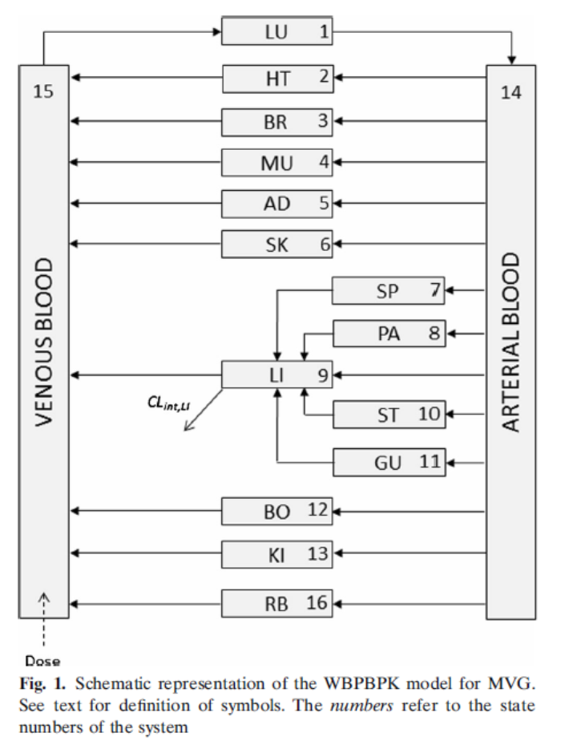
Model Building in nlmixr
You have received a PBPK model for mavoglurant coded in nlmixr
Execute the provided model
Output final population parameter estimates
Produce the following goodness-of-fit plots using xpose.nlmixr
DV vs PRED/IPRED
RES vs PRED/iDV
IWRES vs PRED/iDV
Individual fits
Residual distribution
Run Visual Predictive Checks
After further inspection you noticed that the model was not coded on the log scale which is the standard model syntax for nlmixr
Adjust the code to reflect the model to be coded on the log scale
Follow steps 1) i.-iv.
Compare both model outputs
Wendling T et al. J Pharmacokinet Pharmacodyn (2015) 42:639-657

Slide 4
Acknowledgement
This case and all result files are made available on the github site https://github.com/nlmixrdevelopment/nlmixr-examples

